Slide 1



Spring MVC App - Java Config
m

Slide 2
Java Configuration
•
Instead of configuring Spring MVC app using XML
web.xml
spring-mvc-demo-servlet.xml
•
Configure the Spring MVC app with Java code
No XML!
www.luv2code.com

Slide 3
Development Process
Step-By-Step
Add Maven dependencies for Spring MVC Web App
Create Spring App Configuration (@Configuration)
Create Spring Dispatcher Servlet Initializer
Develop our Spring controller
Develop our JSP view page
www.luv2code.com

Slide 4


Step 1: Add Maven dependencies for Spring MVC Web App
spring-
javax.servlet-api
jstl
javax.servlet.jsp-api
www.luv2code.com

Slide 5



Step 1: Add Maven dependencies for Spring MVC Web App
File: pom.xml
<!-- Spring MVC support -->
<dependency>
<groupId>org.springframework</groupId>
<artifactId>spring-webmvc</artifactId>
<version>...</version>
</dependency>
<!-- Servlet, JSP and JSTL support -->
<dependency>
<groupId>javax.servlet</groupId>
<artifactId>javax.servlet-api</artifactId>
<version>...</version>
</dependency>
<dependency>
<groupId>javax.servlet.jsp</groupId>
<artifactId>javax.servlet.jsp-api</artifactId>
<version>...</version>
</dependency>
<dependency>
<groupId>javax.servlet</groupId>
<artifactId>jstl</artifactId>
<version>...</version>
Will load all supporting dependencies:
spring-core, logging etc …
www.luv2code.com

Slide 6

Step 1: Add Maven dependencies for Spring MVC Web App
File: pom.xml
<!-- Spring MVC support -->
<dependency>
<groupId>org.springframework</groupId>
<artifactId>spring-webmvc</artifactId>
<version>...</version>
</dependency>
<!-- Servlet, JSP and JSTL support -->
<dependency>
<groupId>javax.servlet</groupId>
<artifactId>javax.servlet-api</artifactId>
<version>...</version>
</dependency>
Add Servlet, JSP and JSTL support
<dependency>
<groupId>javax.servlet.jsp</groupId>
<artifactId>javax.servlet.jsp-api</artifactId>
<version>...</version>
</dependency>
<dependency>
<groupId>javax.servlet</groupId>
<artifactId>jstl</artifactId>
<version>...</version>
www.luv2code.com

Slide 7



Customize Maven Build
Need to customize Maven build
File: pom.xml
<build>
Since we are not using web.xml
<pluginManagement>
<plugins>
<plugin>
<!-- Add Maven coordinates (GAV) for: maven-war-plugin -->
<groupId>org.apache.maven.plugins</groupId>
<artifactId>maven-war-plugin</artifactId>
<version>3.2.0</version>
</plugin>
Must add Maven WAR plugin
</plugins>
</pluginManagement>
www.luv2code.com

Slide 8




XML config to Java config
Java Config
Spring @Configuration
web.xml
spring-mvc-demo-servlet.xml
Spring Dispatcher Servlet Initializer
www.luv2code.com

Slide 9

XML config to Java config
Java Config
Spring @Configuration
web.xml
spring-mvc-demo-servlet.xml
Spring Dispatcher Servlet Initializer
No XML!
www.luv2code.com

Slide 10

Flash Back to XML config (the old way)
File: spring-mvc-demo-servlet.xml
<beans>
<!-- Add support for component scanning -->
<context:component-scan base-package="com.luv2code.springdemo" />
<!-- Add support for conversion, formatting and validation support -->
<mvc:annotation-driven/>
<!-- Define Spring MVC view resolver -->
<bean
class="org.springframework.web.servlet.view.InternalResourceViewResolver">
<property name="prefix" value="/WEB-INF/view/" />
<property name="suffix" value=".jsp" />
</bean>
</beans>
Just an FYI
www.luv2code.com

Slide 11

Enabling the MVC Java Config
@EnableWebMvc
•
Provides similar support to <mvc:annotation-driven /> in XML.
•
Adds conversion, formatting and validation support
•
Processing of @Controller classes and @RequestMapping etc ... methods
www.luv2code.com

Slide 12


Step 2: Create Spring App Configuration
File: DemoAppConfig.java
@Configuration @EnableWebMvc
provides similar support to
<mvc:annotation-driven />
@ComponentScan(basePackages="com.luv2code.springsecurity.demo") public class DemoAppConfig {
// define a bean for ViewResolver @Bean
public ViewResolver viewResolver() {
InternalResourceViewResolver viewResolver = new InternalResourceViewResolver(); viewResolver.setPrefix("/WEB-INF/view/");
viewResolver.setSuffix(".jsp");
return viewResolver;
}
}
www.luv2code.com

Slide 13
Step 2: Create Spring App Configuration
File: DemoAppConfig.java
@Configuration @EnableWebMvc
@ComponentScan(basePackages="com.luv2code.springsecurity.demo") public class DemoAppConfig {
// define a bean for ViewResolver @Bean
public ViewResolver viewResolver() {
InternalResourceViewResolver viewResolver = new InternalResourceViewResolver(); viewResolver.setPrefix("/WEB-INF/view/");
viewResolver.setSuffix(".jsp");
return viewResolver;
}
}
www.luv2code.com

Slide 14


View Resolver Configs - Explained
InternalResourceViewResolver viewResolver = new InternalResourceViewResolver();
viewResolver.setPrefix("/WEB-INF/view/"); viewResolver.setSuffix(".jsp");
/WEB-INF/view/
show-student-list
.jsp
View name
www.luv2code.com

Slide 15

Flash Back to XML config (the old way)
File: web.xml
<web-app>
<servlet>
<servlet-name>dispatcher</servlet-name>
<servlet-class>org.springframework.web.servlet.DispatcherServlet</servlet-class>
<init-param>
<param-name>contextConfigLocation</param-name>
<param-value>/WEB-INF/spring-mvc-demo-servlet.xml</param-value>
</init-param>
<load-on-startup>1</load-on-startup>
</servlet>
<servlet-mapping>
<servlet-name>dispatcher</servlet-name>
<url-pattern>/</url-pattern>
</servlet-mapping>
</web-app>
Just an FYI
www.luv2code.com

Slide 16

Web App Initializer
•
Spring MVC provides support for web app initialization
•
Makes sure your code is automatically detected
•
Your code is used to initialize the servlet container
AbstractAnnotationConfigDispatcherServletInitializer
www.luv2code.com

Slide 17
Web App Initializer (more info)
AbstractAnnotationConfigDispatcherServletInitializer
•
Your TO DO list
•
Extend this abstract base class
•
Override required methods
•
Specify servlet mapping and location of your app config
www.luv2code.com

Slide 18


Step 3: Create Spring Dispatcher Servlet Initializer
File:MySpringMvcDispatcherServletInitializer.java
import org.springframework.web.servlet.support.AbstractAnnotationConfigDispatcherServletInitializer;
public class MySpringMvcDispatcherServletInitializer extends AbstractAnnotationConfigDispatcherServletInitializer { @Override
protected Class<?>[] getRootConfigClasses() {
// TODO Auto-generated method stub return null;
}
@Override
protected Class<?>[] getServletConfigClasses() { return new Class[] { DemoAppConfig.class };
}
Our config class from Step 2
}
@Override
protected String[] getServletMappings() { return new String[] { "/" };
}
www.luv2code.com

Slide 19
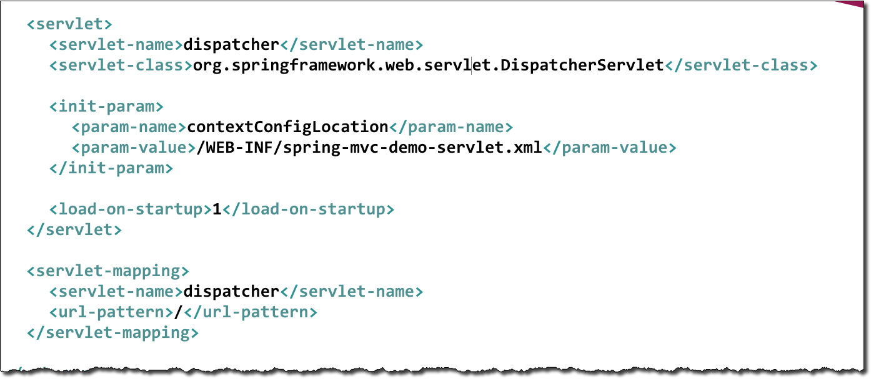

Step 3: Create Spring Dispatcher Servlet Initializer
File:MySpringMvcDispatcherServletInitializer.java
import org.springframework.web.servlet.support.AbstractAnnotationConfigDispatcherServletInitializer;
public class MySpringMvcDispatcherServletInitializer extends AbstractAnnotationConfigDispatcherServletInitializer { @Override
protected Class<?>[] getRootConfigClasses() {
// TODO Auto-generated method stub return null;
}
@Override
protected Class<?>[] getServletConfigClasses() { return new Class[] { DemoAppConfig.class };
}
@Override
protected String[] getServletMappings() { return new String[] { "/" };
}
}
www.luv2code.com

Slide 20

Whew!!!!
Now for the easy stuff
Create Spring MVC Controller and view page easy peazy …
www.luv2code.com

Slide 21


Step 4: Develop our Spring Controller
File: DemoController.java
@Controller
public class DemoController {
@GetMapping("/")
public String showHome() {
return "home";
}
View name
}
/WEB-INF/view/ home .jsp
www.luv2code.com

Slide 22

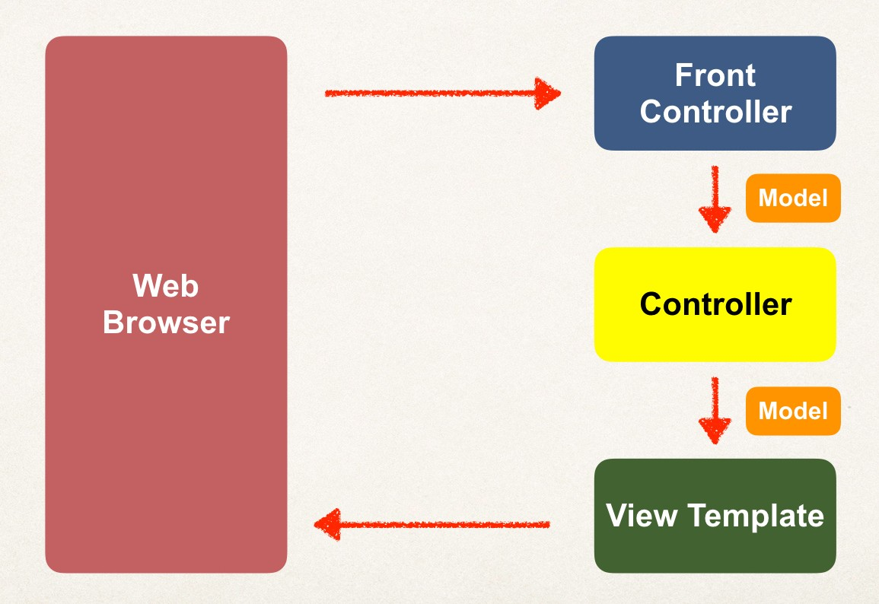

Step 5: Develop our JSP view page
File: /WEB-INF/view/home.jsp
<html>
<body>
Welcome to the luv2code company home page!
</body>
</html>
No XML!
www.luv2code.com

